Slide 1
Groc Share
Sriram Venkatakrishnarao, Karthikeyan Swaminathan & Sagar Thakkar
ESE543 Spring ‘16 (05/02/16)
Code on https://github.com/skarthik91/GrocShare-App
https://github.com/sriramsv/Grocshare-Backend

Slide 2
Motivation
Develop an android application which solves real life problem of students.
Sharing purchases to cross the minimum purchase requirements and get the order through.
Device a solution which considers such constraints at the same time making life easy for both the students and the vendors.

Slide 3
Summary of Contributions
Google based Sign In
Ordering from the Menu List Offered by Vendor Stores.
User based Order Storage and Retrieval(History Order) to and from Cloud Database(Google App Engine)
On the fly merging of orders and dynamically sending the orders to vendor.
Integrating link of Square Cash and Splitwise for account settlements.
Real Time Notification of Order Confirmation.(Google Cloud Messaging)

Slide 4
How do I use Groc Share
What is Groc Share and How do I use it ??

Slide 5
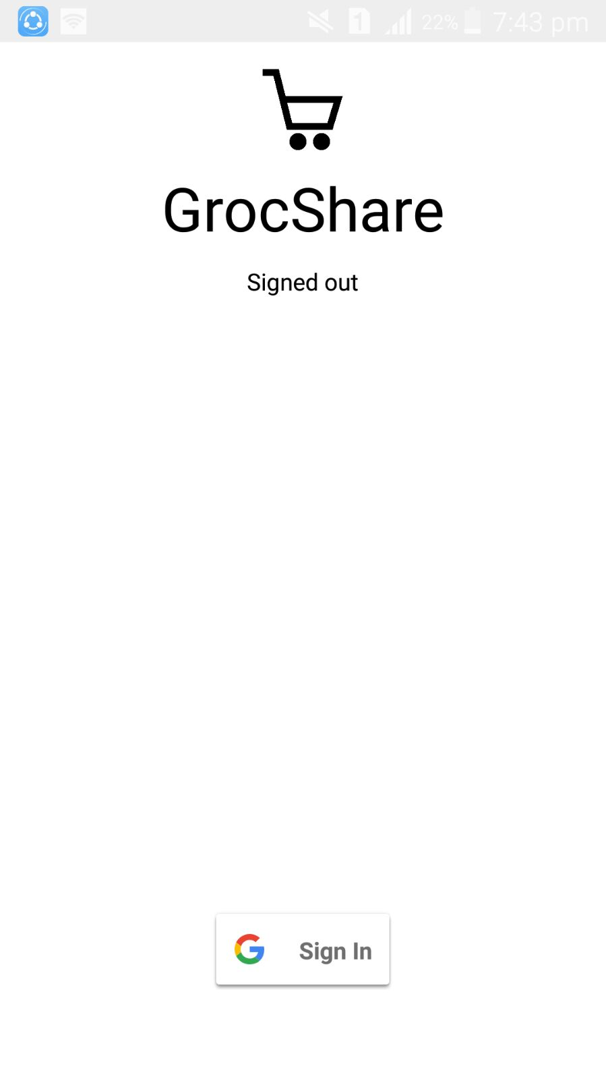
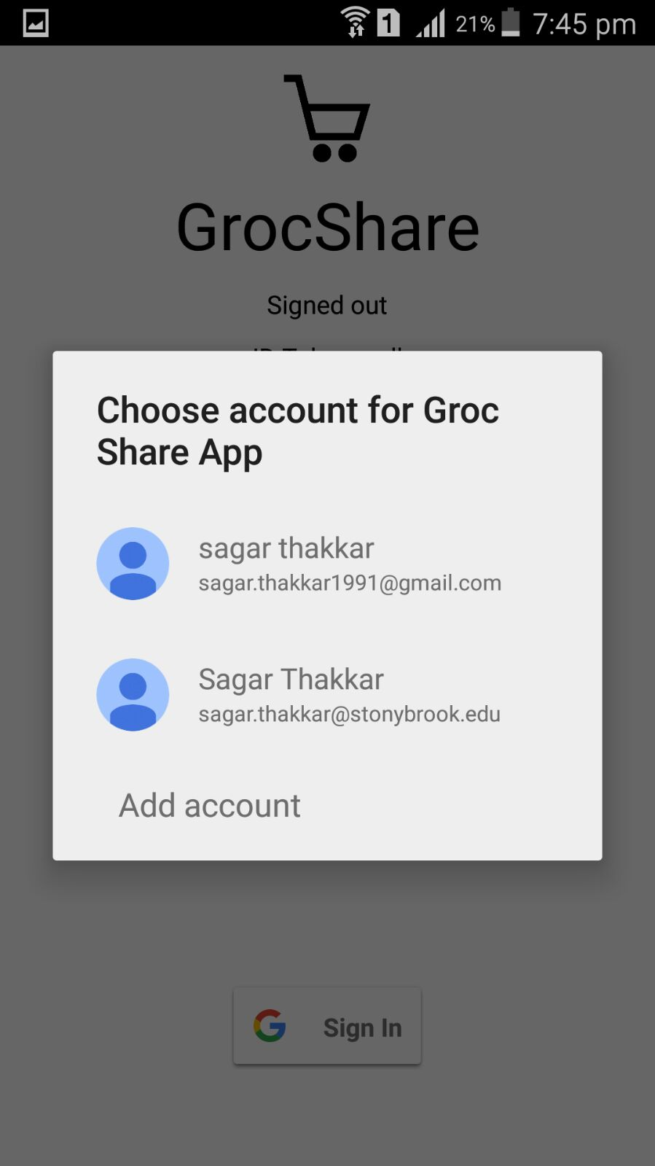
Step 1: Gmail Sign In
Ahh !!! I can use this…:)

Slide 6
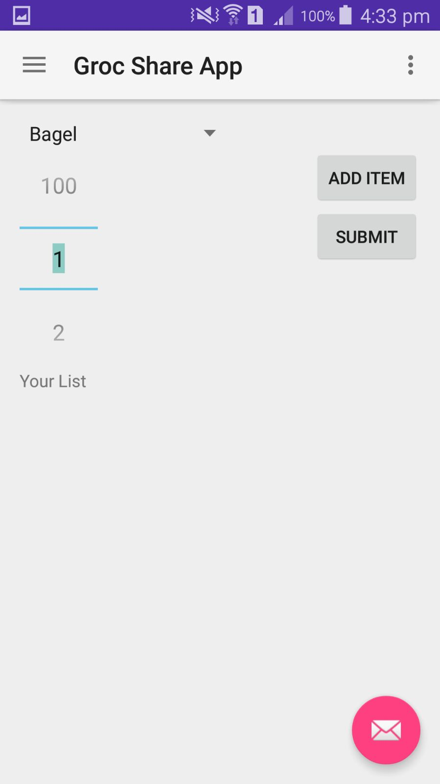
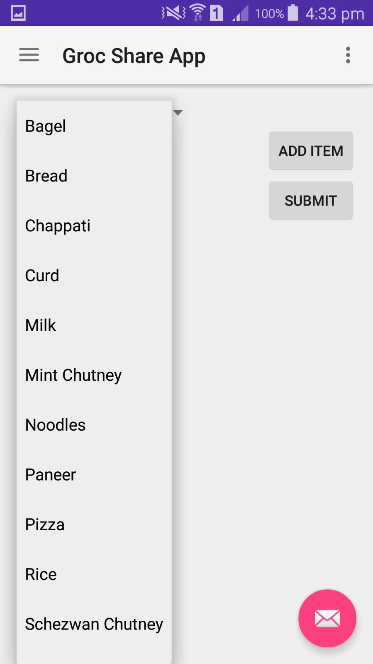
Step 2: Order Screen
The UI seems simple..
Selects Item
Adds Slected Item
Submits the Order
Number Picker

Slide 7
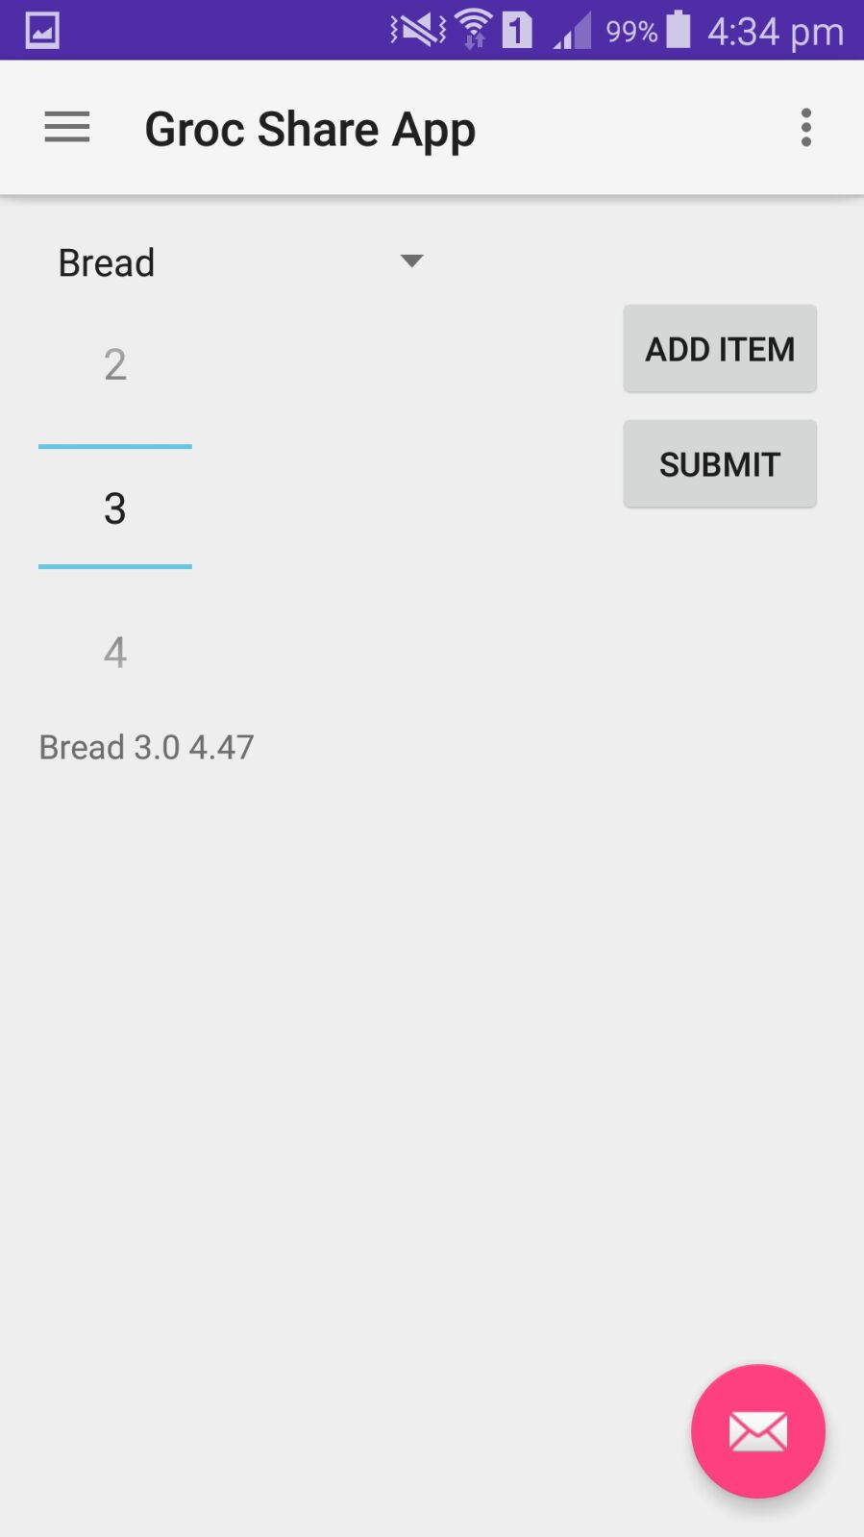
Step 2.1: Order Screen
On clicking Add Item the app selects the order and displays it to the text-view below
The Order Item Particular is displayed here

Slide 8
Opps!!!!! I made a mistake, I want to delete a selected Item...Can this app give this functionality ????

Slide 9
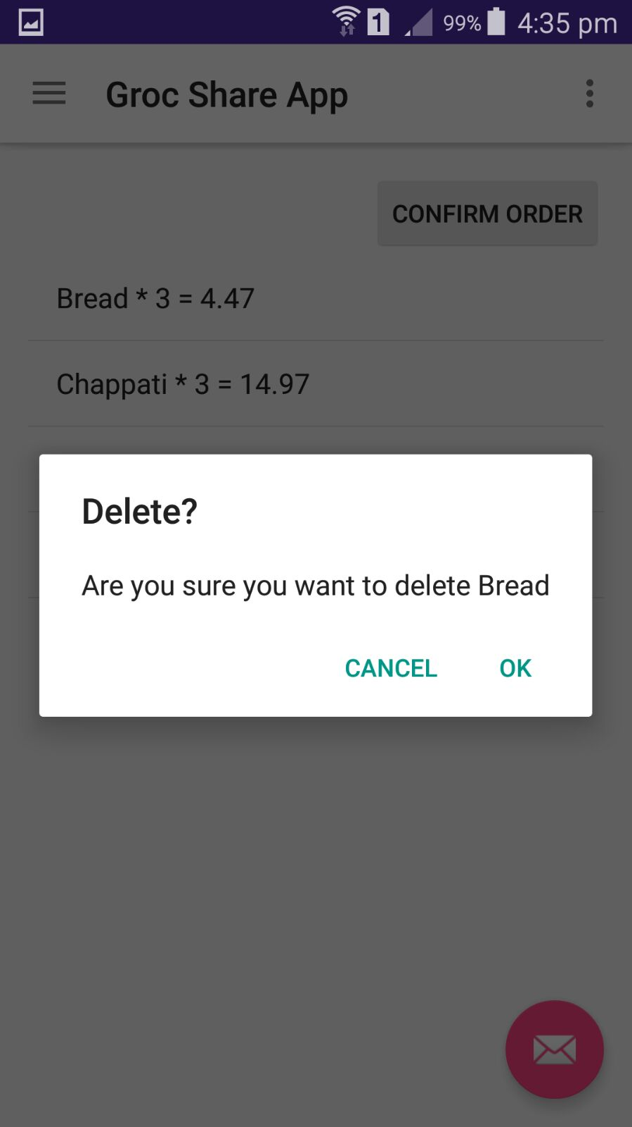
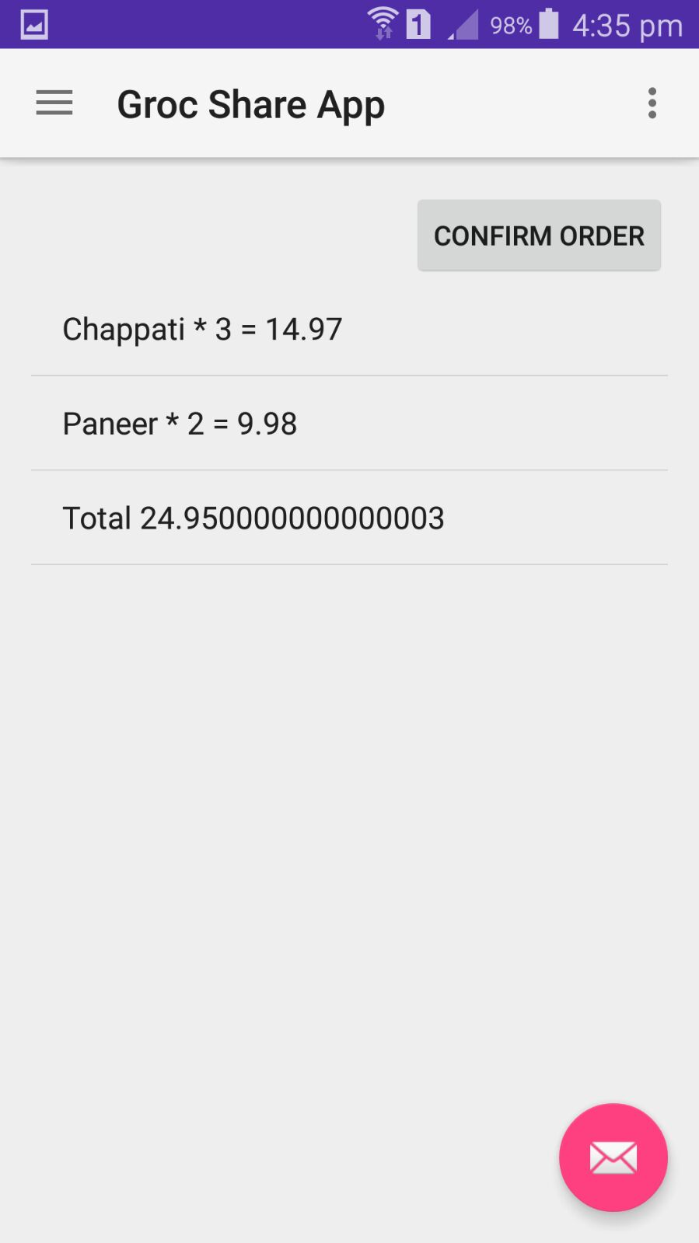
Step 2.2: Remove Order Item
Bread Deleted
On clicking any item in the Order List, it gives an option to delete that order item.
On Selecting Ok the order Item gets deleted(See adjacent Image)

Slide 10
Step 2.3: Order Confirmation to Cloud
On Clicking confirm order the entire order is sent to cloud.
The List of all the orders placed is shown here

Slide 11
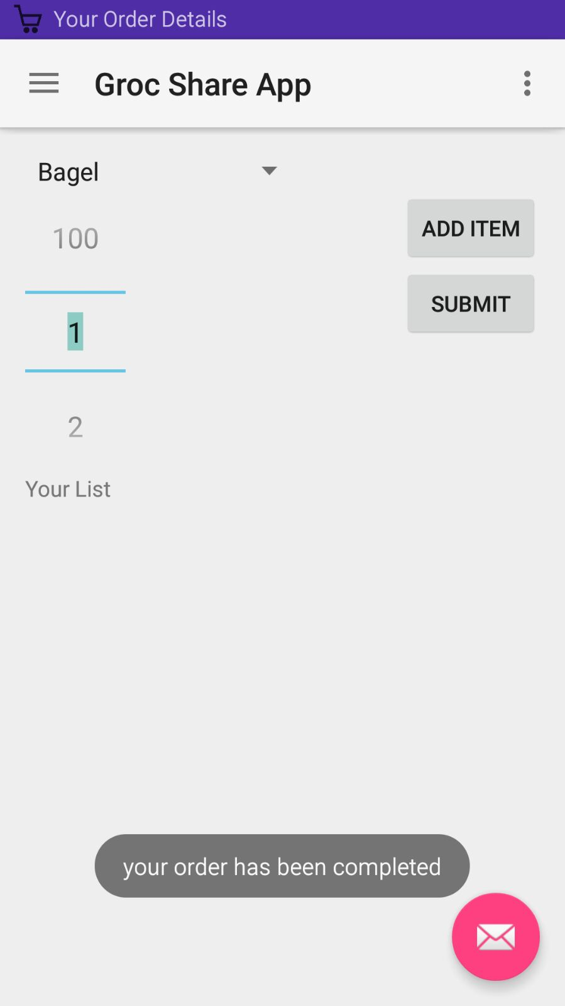
Step 2.4: On Order Confirmation
On successful order the app gets back to the main screen giving the notification that the order is placed and sets the app ready for another order to be placed.
Successful Order Sent

Slide 12
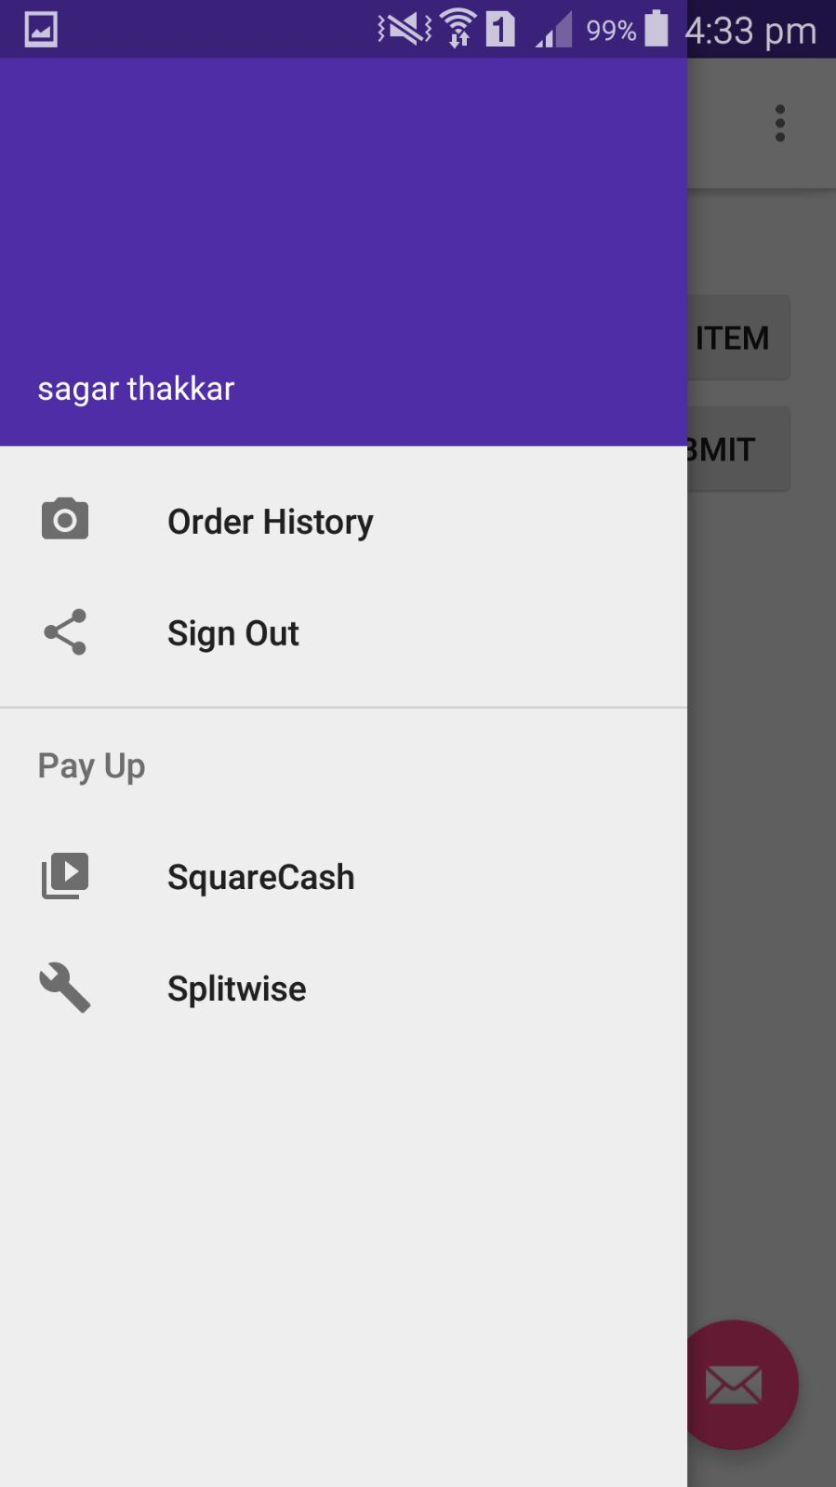
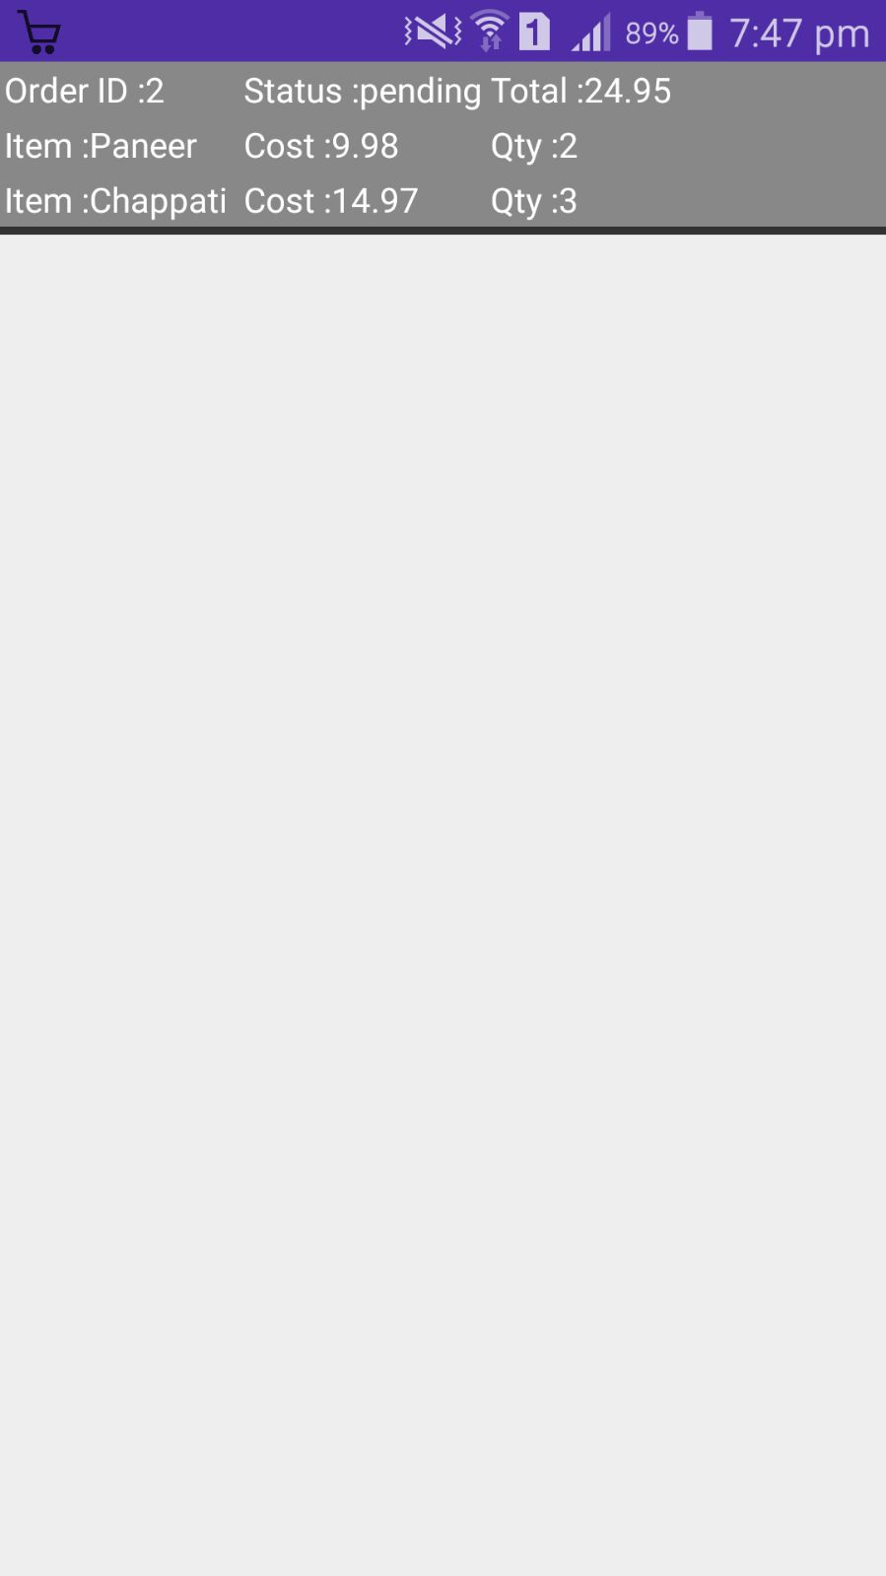
Step 3: History Orders
On clicking Order History You can view your history orders as shown in the adjacent image.
What are my historical orders and whats the status ?

Slide 13
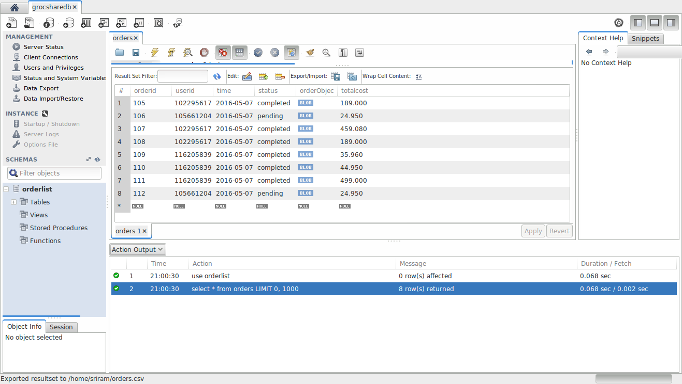
Step 4: On the fly storage and Order Merging

Slide 14
The backend seems a bit complex.However,the app seems really simple to use.Can I also put the order details on Splitwise or Settle Up my accounts……?????

Slide 15
Step 5: Split Wise and Square Cash
On clicking the Splitwise or SquareCash Option you can use for group accounts settling.

Slide 16
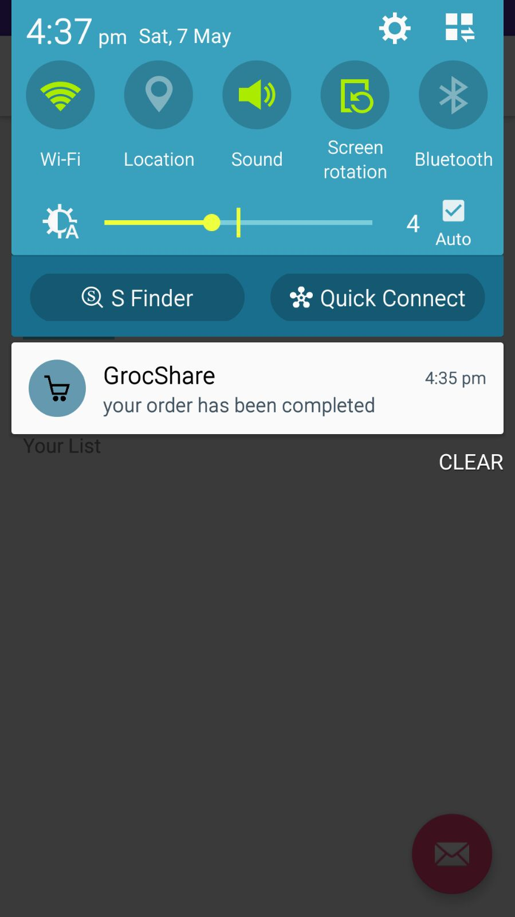
Step 6.1: GCM Notification on Order Placement
Is single order >= 25 $
Are merged orders >= 25$
SEND NOTIFICATION

Slide 17
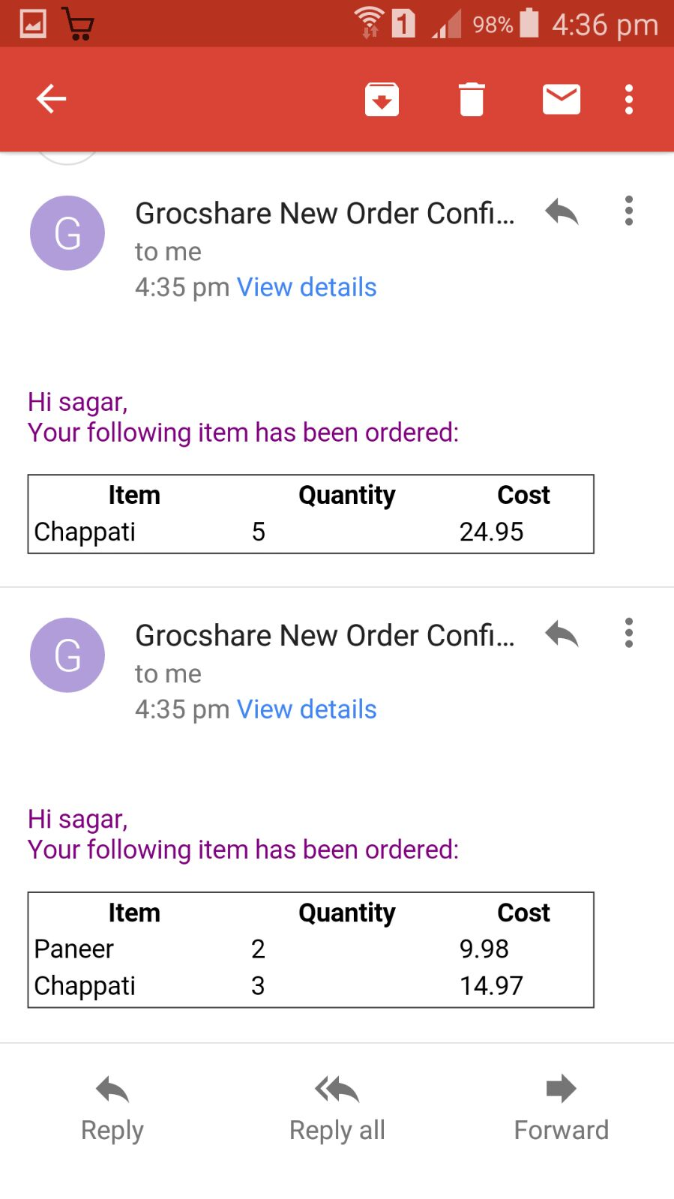
Step 6.2: MAIL Notification on Order Placement
Is single order >= 25 $
Are merged orders >= 25$
SEND NOTIFICATION

Slide 18
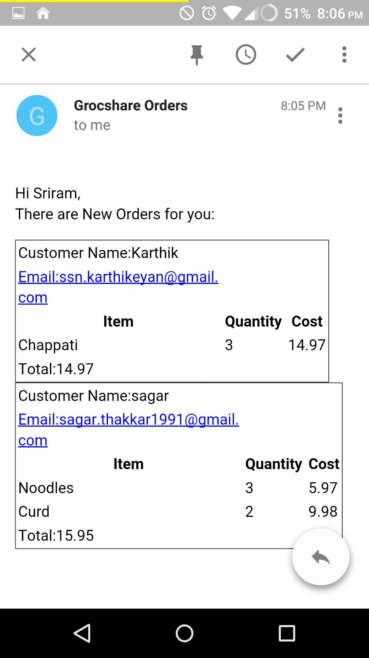
Step 6.2: MAIL Notification on Order Placement

Slide 19
Application Demo
Groc Share App Video

Slide 20
Thank you
Acknowledgement: We would like to thank Prof. Shan Lin for giving us the liberty to explore the possibilities and help us with involvement through discussions.

